Slide 1


Corticeira Amorim: Innovating the Future TEAM ABC Riddhi Malviya | Siwen You | William Skudlarek | Jane Wang
Kuala Lumpur, Malaysia
Innovate. Disrupt. Transform.

Slide 2



Corticeira Amorim should expand, innovate, and partner
1
EXPAND
3 Part Strategy
Expand into new markets through manufacturing customized cork
Although demand for wine is rising within current markets, there are untapped potential markets for growth in new countries
Become the new alternative material for real estate, athletics, and pharmaceuticals in order to diversify Amorim’s product offerings
Partnerships and agreements with wine manufacturers, construction and biomedical companies
2
INNOVATE
Innovate through new products for interior design and other industries
3
PARTNER
Partner with production companies to agree on as exclusive supplier

Slide 3
3 Part Strategy: Expand

Slide 4
Corticeira Amorim should expand in current and future markets
Portugal
Potential Markets
Existing Markets
Consumer
Producer
Italy
France
Spain
China
US
Australia
South Africa

Slide 5

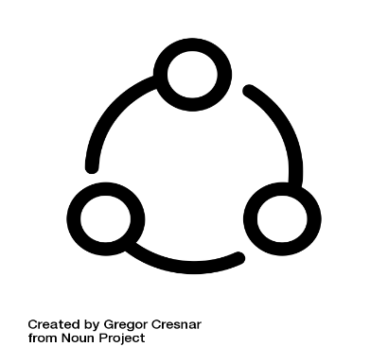
Reinforce Amorim’s presence in Existing Markets
Existing Markets
Spain
France
Italy
More agglomerated cork for sparkling wine
Stronger connections through incentive programs
Identify industry trends and benchmarks
Encourage wine producers to market high-end branding
Notes:
Incentive programs → loyalty and discount programs.

Slide 6


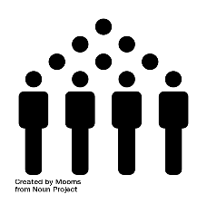

Production of Wine in Potential Markets
Assumptions of potential production of wine
Geographic
advantages
Climate
Population
Policy

Slide 7
Wine Production by US
Average Predicted Growth
Sparkling wine
1.77%
Still wine (bottled)
3.08%
Still wine (bulk)
4.21%

Slide 8
Demand of Wine in Existing and Future Markets

Slide 9
Establish Amorim’s presence in foreign markets
USA
Estimated to grow 7% annually
Estimated Revenue
$986 Million
Notes:
Mention Napa will affect demand (a little bit)

Slide 10
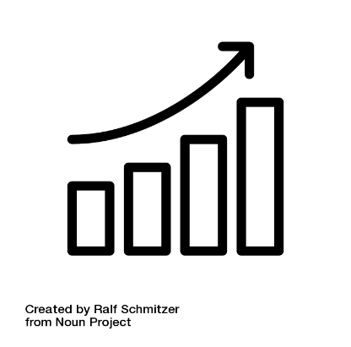


Establish Amorim’s presence in foreign markets
CHINA
Percentage of adults is increasing
GDP is growing
Very large population
Purchasing power increases
Corporate industry is expanding
Demand in high-end market is growing

Slide 11
Future Potential Markets for Growth
South Africa
Australia
Future manufacturing potential
Climate advantage for production
Developing country
Cheap labor
Upcoming country
Investment potential
Capital growth
Establish relationship early on
Closely monitor the market trend
Potential buyer
Product in high demand
Already famous in producing wine
Exports oriented
Has stable supply and demand chain
In good relations with foreign markets
Recognize the market for high-end wine, and replace screw cap
Promote easier way to recycle, quickly dissolve to the ground, more sustainable

Slide 12
3 Part Strategy: Innovate

Slide 13
Current Product Recommendations
Cork Closures
Difficulty in opening, corkscrew requirement
Incorporate built in opener around cork as an add-on
Patent and license cork add-ons to wineries and bottlers
Creates new revenues stream
Bacterial safety concerns
Mitigate bacterial cross-contamination in bottling process
Reduces potential liability for clients garnering new sales opportunities
Other segments
Promote turf fields, infrastructure, and solvents more aggressively
Cork not recognized as consistent competitor in periphery markets

Slide 14
Innovate new ventures to capture growing markets
28%
Non-closures only represent 28% of the total cork market which has room for growth
Expanding to new markets limits dependency on wine and spirits market and diversifies client industries
Correlation between wine production and cork sales is high
Cork competitors have yet to fully penetrate other markets
Cork already known to most consumers through the closure market
Use existing supply chain networks to other countries to export products
Notes:
Better production and decrease costs
*VARIABLE COSTS & the Economy
Analyze cost trend
Although closures represents a prospering segment of the global market for cork, there is significant opportunity to establish new ventures and create new revenue streams

Slide 15
3 Part Strategy: Partner

Slide 16

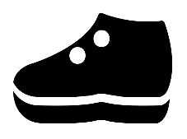


Potential New and Underutilized Market Partnerships
Real Estate and Infrastructure
Sport, Music, and Apparel
Flooring, Walls, and Insulation
Furniture
“Green” Housing Growth
Public Works Projects
Versatility in Lifecycle
Turf fields inert
Sport projectiles
Hats, Bags
Acoustic improvements
Closure Enhancements
Pharmaceuticals
Susceptible to cross-contamination
Higher costs
Regain closure market share
IV Insulation
Chemical storage
Other medical applications

Slide 17
Implement

Slide 18
World Projections of Demand for Wine
Notes:
From our analysis of the data given, we have come up with predictions for the future demand of wine worldwide which we expect to increase by roughly 10% over the next 5 years. As the wine consumption increases, we hope to help Amorim capture a good percentage of that growing market as well as expand into different markets.

Slide 19
Implementation Timeline
2018
2019
2020
2021
2022
2023
Expand
Establish presence current markets by customizing
Analyse and explore new markets for expansion
Enter new markets
Innovate
Research and develop new uses of the cork
Create and market new products
Partner
Find Potential Partners
Form agreements
Notes:
Entering new markets when demand for wine is high (Halloween, Thanksgiving, New Years)

Slide 20


Risks and Mitigations
Risks
Mitigations
Natural Disasters
Market Demand Fluctuations
New Competitors
Diversify production areas
Increase product variety
Be a leader in innovation
Notes:
Diversify production areas = Expand production areas to Spain, Morocco, and Algeria where there is a lot of forest area.
Increase product variety = cater to different industries other than wine and thus becoming less dependent upon the demand and consumption of wine
Be a leader in innovation = continuously research and create new ideas to stay ahead of our competitors remaining at the forefront of innovation, creativity, and sustainability.

Slide 21



Corticeira Amorim should expand, innovate, and partner
3 Part Strategy
EXPAND
INNOVATE
PARTNER
Expand into new markets through manufacturing customized cork
Innovate through new products for interior design and other industries
Partner with production companies to agree on as exclusive supplier
Notes:
Expand → in current markets through customized corks and incentive programs and potential markets as the new sustainable alternative
Innovate → research and launch new products within the housing, biomedical, and sporting industry while remaining true to the mission of valuing nature
Partner → partner with wineries, construction companies, and other industries as their exclusive supplier and cement ourselves around the world as the innovative new material

Slide 22
Thank you for your time
Presented by:
Riddhi Malviya
Siwen You
William Skudlarek
Jane Wang

